Slide 1


Introduction To ATM

Slide 2

What we will cover
Module 1 : B-ISDN and ATM
Module 2 : ATM Concepts
Module 3 : ATM Protocol Reference Model
Module 4 : ATM Physical Layer
Module 5 : ATM Layer
Module 6 : ATM Service Categories
Module 7 : ATM Adaptation Layers
Module 8 : ATM Traffic Management
Module 9 : Signaling in ATM
Module 10 : Related Areas and Developments

Slide 3

Jargon Used
ATM: Asynchronous Transfer Mode
B-ISDN: Broadband Integrated Services
Digital Network
CBR: Constant Bit Rate
VBR: Variable Bit Rate
ABR: Available Bit Rate
UBR: Unspecified Bit Rate

Slide 4
Jargon Used
AAL: ATM Adaptation Layer
SAAL: Signaling AAL
UNI: User-Network Interface
PNNI: Private Network-Network Interface
PMP: Point-to-Multipoint
LIJ: Leaf Initiated Join

Slide 5
Module 1
B-ISDN and ATM

Slide 6
Broadband ISDN (B-ISDN)
All purpose digital network
Aims to provide an integrated access that will support a wide variety of applications in flexible and cost effective manner
Suitable for both business and residential customers
It will provide high speed data links with flexible bit-rate allocation

Slide 7
B-ISDN Services
Conversational (or Interactive) Services
  Real time end to end information transfer
  Can be bidirectional or Unidirectional.
  Telephone, Tele-education, video conferencing etc.

Slide 8
B-ISDN Services
Messaging Services
  Communication via storage units (mailbox etc)
  Emails, Video Mails

Slide 9
B-ISDN Services
Retrieval Services
  Provide users with capability to retrieve information stored elsewhere
  High Resolution Image Retrieval, Document Retrieval Services.

Slide 10
B-ISDN Services
Distributed Services
  Video and Audio transmission services.
  Electronic Newspaper
  Video Services:
    TV Program Distribution
    Digital Video Library

Slide 11
Types of Transfer Modes
Different techniques to transfer Data and Voice:
Circuit Switching (Voice Transfer)
Packet Switching (Data Transfer)

Slide 12
Circuit Switching
A circuit is established for the duration of the connection
Based on Time Division Multiplexing (TDM)
  also called Synchronous Transfer Mode (STM)
Based on recurring structure : Frame

Slide 13
Circuit Switching
A channel is identified by position of its time slots within the frame
  A channel is assigned a fixed number of slots within each frame
Time
Slot
Framing Bit
Channel 1
Channel 2
Channel n
Frame

Slide 14
Circuit Switching
Low Switching Delay : Switching in Hardware
Low Delay Variance
No overheads of Packetization
  No routing, No link level Error Control

Slide 15
Circuit Switching
Highly Inflexible
  Fixed Bandwidth Allocation : Multiple of 64 Kbps
  Synchronization Problems between various channels of a connection.
  Selection of Basic channel bandwidth is a complicated issue.
Inefficient for variable bit-rate traffic
  bandwidth is allocated at the peak rate

Slide 16
Packet Switching
Packet = User Data + Header
  Header for Routing, Error and Flow Control
Variable Packet Length
Complex link - to - link protocol
  Error and flow control
Store and Forward Switching
Statistical sharing of resources

Slide 17
Packet Switching
Best Effort transfer
  Due to congestion in switches, packet loss might occur
  Resources are not reserved for different applications

Slide 18
Packet Switching
Variable Length Packets require complex buffer management schemes
Variable Processing and Switching Delays
Low efficiency for small size packets
  Due to high header overheads

Slide 19

Which Switching Technique do we use for B-ISDN?

Slide 20

Combine best Packet and
Circuit Switching Features
Flexible Bandwidth and Statistical Multiplexing
  Packet Switching : Virtual Circuit
Low Delay Variation (Jitter)
  Fixed Route for all packets of the connection

Slide 21
Combine best Packet and
Circuit Switching Features
Less Delay for Voice & real-time applications
  Small packet size (32 or 64 Bytes): Less packetization time
  Fixed Packet size for less switching and processing time
High Transmission Efficiency
  Reduce header overheads : No link by link flow and error control

Slide 22
Virtual Circuit Concept
Logical Connection
Connection is first established using signaling protocol
  Route from the source to the destination is chosen
  The same route is used for all cells (fixed size packets) of the connection
No routing decision for every cell

Slide 23
Virtual Circuit Concepts
No dedicated path ( unlike Circuit Switching)
Each Link of the network is shared by a set of virtual channels
  Each cell uses only virtual channel number
Each packet contains enough information for node (switch) to forward it towards the destination

Slide 24
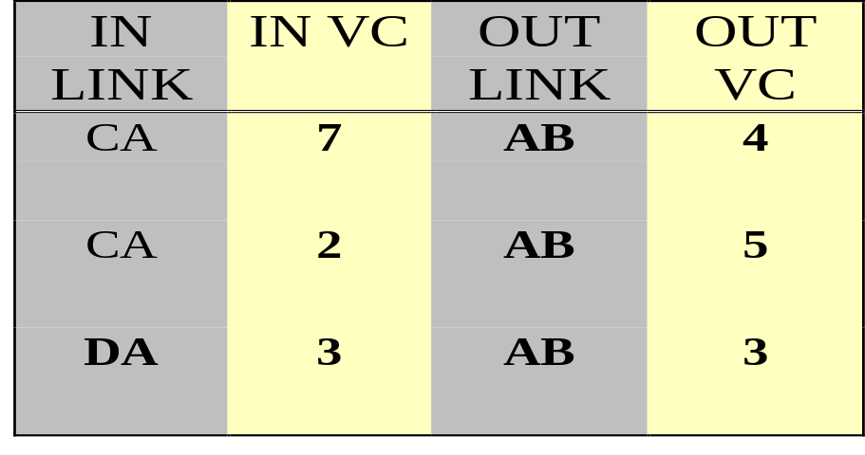
Virtual Circuit
E
VC3
C
VC7
VC3
VC4
B
VC2
A
VC5
VC2
VC3
D
VC3
VC5
F
Table at Node A

Slide 25
Virtual Circuit Concept
Signaling protocol establishes Virtual Circuit
  Tables in all nodes are filled
Parameters used for establishing Virtual Circuits
  Calling and Called Party Addresses
  Traffic Characteristics
  QoS Parameters

Slide 26
Advantages of Virtual Circuit
In order delivery of packets or cells
Fast Delivery (no routing decision for each packet)
Less Header Overhead
High efficiency when two stations exchange data for long time

Slide 27
Handling Congestion with VC
Establishing Virtual Circuit alone not sufficient to avoid congestion
Declare Traffic Characteristics and QoS requirements
Reserve Resources while establishing Virtual Circuit

Slide 28
Requirements of Virtual
Circuit Technology for B-ISDN
Performance Requirements
  Support for flexible bandwidth (Variable Access Rate)
Limited Error Rate
    Bit Error Rate < 10⁻⁷ to 10⁻¹⁰
    Packet Loss Rate < 10⁻⁵ to 10⁻⁷

Slide 29
Requirements of Virtual
Circuit Technology for B-ISDN
Limited Delay and Delay Variation (Jitter)
    delay < 25 ms for telephony
    limited delay for real-time applications
    limited delay-variation for voice communication

Slide 30
ATM : Solution for B-ISDN
Suitable for both real-time and non real-time applications
Suitable for both loss-sensitive and loss-insensitive applications
Seamless networking
  LAN to MAN to WAN
  to carry Voice, Telephony, Multimedia, Data traffic

Slide 31
Module 2
ATM Concepts

Slide 32
ATM Concepts
ATM is based on Virtual Circuit Technology
Virtual Circuits have many advantages over Datagram and Circuit Switching
Similar to Circuit Switching, ATM uses signaling protocol to establish Circuit before data communication commences

Slide 33
ATM Concepts
Unlike Circuit Switching, ATM is based on Statistical Multiplexing (Similar to Packet Switching)
In order delivery of Cells due to Virtual circuits

Slide 34
ATM Concepts
No error protection or flow control on a link by link basis
  Links are assumed to be high quality with low bit error rate
  Preventive actions: Proper resource allocation and queue dimensioning to reduce packet loss
  End-to-End error protection and recovery.

Slide 35
ATM Concepts
Flow control by input rate control and capacity reservation
Congestion control : Avoid congestion
  Drop cells when congestion occurs
Fixed size packets called Cells
  size 53 bytes = 48 bytes payload + 5 bytes header

Slide 36
Cell Size
Based on :
  Transmission efficiency
  End-to-end delay
    Packetization delay
    Transmission delay
    Switching delay

Slide 37

Why Small Cells ?
%Overhead
Overhead
Delay
Delay (ms)
0
20
60
80
Payload (bytes)

Slide 38
Cell Size: 32 bytes or 64 bytes?
Cell size of 32 and 64 bytes:
  64 bytes cells have better transmission efficiency
  32 bytes cells have small delay
  both sizes are integer power of 2
Europe wanted 32 bytes size, US and Japan wanted 64 bytes size
Compromise: 48 bytes

Slide 39
ATM Cell Format
Header :5 bytes Payload (Information) 48 bytes
at
UNI
at
NNI
C
L
P
GFC VPI VCI PT HEC
4 8 16 3 1 8 bits
C
L
P
VPI VCI PT HEC
12 16 3 1 8 bits
GFC : Generic Flow Control VPI : Virtual Path Identifier
VCI : Virtual Circuit Identifier PT : Payload Type
CLP : Cell Loss Priority HEC : Header error Check
UNI : User Network Interface NNI : Network-Network Interface

Slide 40
ATM Concepts
Reduced header functionality
  Provision for multiplexing, head-error detection / correction and limited control and maintenance function
  No sequence number
  No destination and source address
5 bytes 48 bytes
Header Payload

Slide 41

Asynchronous
Multiplexing of Cells
Packetizer
Digital Pipe
Voice
Cells
Data
Video
Multiplexer

Slide 42
Features of ATM
Simple queue management and Cell processing due to the fixed size cells
Suitability for
  delay sensitive and loss insensitive traffic
  delay insensitive and loss sensitive traffic
Quality of Service (QoS) class support
Switched Access
  Multiple Access Speeds (25 Mbps - 155 Mbps)
Easily Scalable

Slide 43
Module 3
B-ISDN ATM Protocol Reference Model

Slide 44
B-ISDN ATM Protocol
Reference Model (PRM)
MGMT
CONTROL USER
L P
A L
Y A
E N
R E
Higher Layers
ATM Adaptation Layer
(AAL)
ATM Layer
Physical Layer

Slide 45
ATM PRM
Control Plane : Used for connection control, including connection setup and release functions.
User Plane : Data is transmitted using one of the protocols in the user plane once the connection is established.
Management Plane : Management functions relating to User and Control Planes.

Slide 46
Layered Architecture
AAL
AAL
ATM
ATM
PHY
PHY
UNI
ATM Network
UNI

Slide 47
ATM Adaptation Layer
Provides mapping of different type of applications to ATM service of the same type
Segments and Reassembles into 48 byte payload
Accepts, Delivers 48 byte payloads to ATM layer

Slide 48
ATM Adaptation Layer
AAL
AAL
1 : Circuit Emulation
2 : Audio / Video
3/4 : Data Transfer
5 : Lower Overhead
AAL for Data
Audio
48 bytes
Video
Data
To
ATM Layer
Data

Slide 49
ATM Layer
Header Processing
  Adding / Removing header top 48 byte payload
Handling of Connection Identifiers
  VCI and VPI translation
Cell Multiplexing and Demultiplexing
Generic Flow Control

Slide 50
ATM Layer
48 byte
Payloads
from AAL
To Physical Layer

Slide 51
Physical Layer
Transmission frame adaptation
Cell delineation
Cell rate decoupling

Slide 52
ATM Network Interfaces
Private
UNI
Regional Carrier
Private
Switch
Public
UNI
Computer
Public
Switch
Public
Switch
Private
NNI
Public
NNI
Private
UNI
Computer
B-ICI
Private
Switch
Public
Switch
Digital
Service
Unit
Public
UNI
B-ICI
Computer
Router
DXI
Public
Switch

Slide 53
Module 4
ATM Physical Layer

Slide 54
Physical Layer
Introduction
Physical Medium Choices at UNI and NNI
TC Sublayer
Cell Delineation
Cell Payload Scrambling

Slide 55
ATM Physical Layer : Introduction
Physical medium to carry ATM cells
Two sublayers
  Transmission convergence (TC) sublayer
  Physical Medium Dependent (PMD) sublayer

Slide 56
Transmission
Convergence Sublayer
Transmission Convergence Sublayer
    Convert bit stream to cell stream
    Transmission Frame Adaptation : Packing Cells into Frame
    cell delineation : Scrambling and Cell recovery
    HEC generation / verification
    Cell Rate Decoupling : Insertion and Suppression of idle cells

Slide 57
PMD Sublayer
Physical Medium Dependent Sublayer
  Fiber, Twisted pair, Coax, SONET, DS3
  Functions
      Bit timing
      Line coding

Slide 58
Cell-Stream Physical Layer
Cell
  cells are transmitted as a stream without any regular framing
  OAM cells are identified by VPI:0, VCI:9
  Synchronization is achieved by Transmission Convergence Sublayer

Slide 59
Physical Medium Choices
Plesiochronous Digital Hierarchy (PDH) based Interfaces
  uses existing transmission network infrastructure
  DS1(1.544Mbps), E1 (2.048 Mbps), E3 (34.368 Mbps) , DS3 (44.736 Mbps), E4 speeds
  Cell Delineation and Synchronization with HEC
25.6 Mbps UTP

Slide 60
SONET / SDH Based
Physical Layer
  Synchronous Optical Network: (SONET)
  Synchronous Digital Hierarchy (SDH)
  Lower speed ATM streams can be multiplexed over higher speed SONET streams
  SONET supports a hierarchy of digital signals with a basic rate of 51.84 Mbps
  Based on Time Division Multiplexing

Slide 61
SONET / SDH Based
Physical Layer
  H4 octet in the path header indicates offset to the boundary of the first cell following H4
  Parts of a cell may be carried over two successive SONET frames

Slide 62
SDH Physical Layer for ATM
The most common physical layer to transport ATM cells in public networks
Standards are defined for encapsulation of ATM cells in SDH (SONET) frames

Slide 63
SDH Physical Layer for ATM
Total : 9 Rows * 270 Columns
STM-1/STS-3c : 9*260*8/125 μsec =145.76 Mbps payload
Path
Overhead

Slide 64
Cell Delineation
Identifies cell boundaries in a cell stream
Physical layers may use their own mechanisms
  SONET uses H4 pointer

Slide 65
Cell Delineation
CCITT Recommended HEC-based Algorithm
  Generic
  Can be used with cell-stream when there is no framing structure
  Contrast with Marker based framing

Slide 66
Cell Delineation by
HEC Field
correct HEC
bit-by-bit
check
cell-by-cell
check
Initially HUNT state
Bit-by-bit check to match computed HEC with the received HEC
CCITT recommendation
→ < 7
δ < 6
HUNT
PRESYNC
Incorrect HEC
SYNC
δ consecutive
correct HEC
→ consecutive
incorrect HEC

Slide 67
Cell Payload Scrambling
At source, scramble the cell payload
At receiver, descramble the cell payload
To increase the security and robustness
  To protect against malicious users or unintended simulation of a correct HEC in the information field

Slide 68
Summary
Wide range of Physical Interfaces are available :
  DS1 to STS-12
ATM Cells can also be carried over (standards are being defined)
  Satellite
  Wireless
Two Sublayers : Convergence Sublayer and Physical Medium Dependent sublayer

Slide 69
Module 5
ATM Layer

Slide 70
ATM Cell Format
Header :5 bytes Payload (Information) 48 bytes
at
UNI
at
NNI
C
L
P
GFC VPI VCI PT HEC
4 8 16 3 1 8 bits
C
L
P
VPI VCI PT HEC
12 16 3 1 8 bits
GFC : Generic Flow Control VPI : Virtual Path Identifier
VCI : Virtual Circuit Identifier PT : Payload Type
CLP : Cell Loss Priority HEC : Header error Check
UNI : User Network Interface NNI : Network-Network Interface

Slide 71
ATM Cell Format
GFC
C
L
P
VPI VCI PT HEC
4 8 16 3 1 8 bits
GFC : Generic Flow Control ( 4 bits)
Used for flow control at UNI
Exact GFC procedure is not yet defined
PT: Payload
  Type of payload carried within a cell
    user data
    operation and maintenance data (OAM)

Slide 72
ATM Cell Format
  Contains congestion indication (CI) bit
  CI bit may be modified by any switch to indicate congestion to end users
PT Interpretation
000 User Data; type 0; no congestion
001 User Data, type 1; no congestion
010 User Data; type 0; Congestion
011 User Data; type 1; Congestion

Slide 73
ATM Cell Format
PT Interpretation
100 OAM Cell
101 OAM Cell
110 Resource Management Cell (to be defined)
111 Reserved for future use

Slide 74
ATM Cell Format
CLP : Cell loss Probability (1 bit)
Indicates relative priority of a cell
Indicates if a cell can be discarded in case of congestion
  CLP = 0; High priority; cell not to be discarded
  CLP = 1; Low priority; cell may be discarded
CLP bit is set by the user or by the service provider
  IN CBR connection, cells have CLP = 0

Slide 75
Virtual Circuits in ATM
Virtual Circuit Identifier is represented jointly by:
  Virtual Channel Identifier (VCI)
  Virtual Path Identifier (VPI)
Virtual Channel (VC)
  Path for cell associated with a connection
  Supports transportation of a data stream
  Each VC is assigned a unique VCI on a link

Slide 76
Virtual Channels in ATM
Virtual Path (VP)
Grouping of virtual channels on a physical link
Switching can be performed on the path basis:
  reduced overheads
Each virtual path is assigned Virtual Path Identifier (VPI)

Slide 77
VCs In ATM
Virtual Path
Transmission Path
Virtual Channel

Slide 78
Virtual Path Switch
(VP - Switch)
VP - Switch
VP1
VP4
VC1
VC2
VC3
VC4
VC5
VP5
VP2
VC3
VC4
VC5
VC!
VC2
VP3
VP6
VC6
VC7
VC6
VC7

Slide 79
VP / VC Switch
VC3
VC2
VC1
VC2
VC1
VC3
VP3
VP1
VC2
VC3
VC1
VP4
VP2
VP5
VC4
VC5
VC4
VC5
VP/VC Switch

Slide 80
Why VPI / VCI rather than a single VC number?
Semi-permanent VP reduces the setup time
VCs can be easily added to the existing VPs
Reduced size of the routing table
Separate groups for different types of streams: voice, data, and video
Different QoS can be applied to different VPs

Slide 81
Summary
Cell multiplex and demultiplex
  In the transmit direction, cells from different streams are multiplexed into one stream
  At the receiving side, incoming cells are demultiplexed into individual streams
Cell VPI/VCI translation
Cell header generation - extraction
  Excepting HEC

Slide 82
Module 6
ATM Service Categories

Slide 83
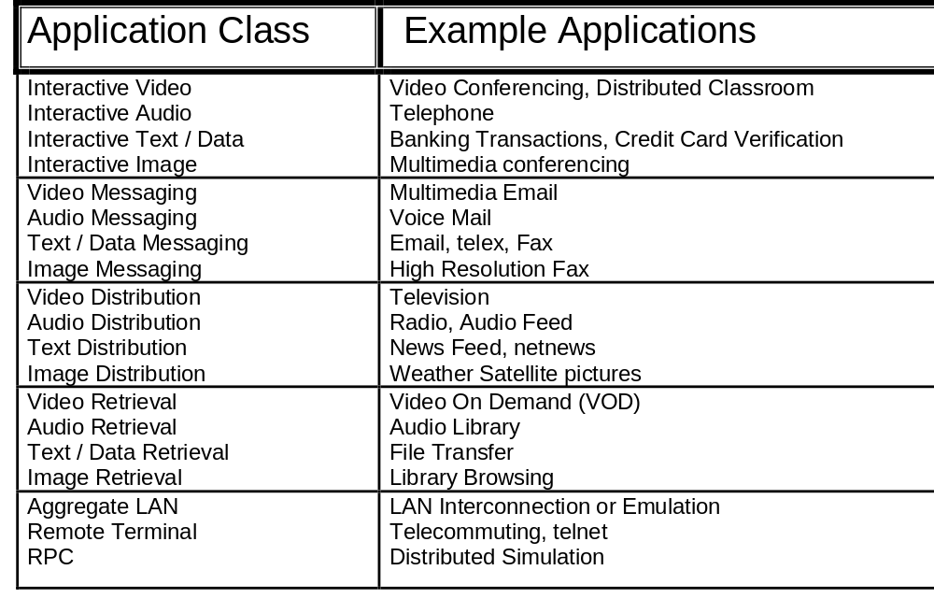
Applications On ATM

Slide 84
ATM Service Categories
CBR : Constant Bit Rate
rt-VBR : Real-time Variable Bit Rate
nrt-VBR : Non Real-time Variable Bit Rate
UBR : Unspecified Bit Rate
ABR : Available Bit Rate

Slide 85
ATM Service Categories
Elastic ABR
traffic
Trunk Bandwidth
ABR
VBR
CBR
UBR
VBR
CBR
ABR
Feedback from Network

Slide 86
Constant Bit Rate (CBR)
Emulates a copper wire or optical fiber (circuit emulation)
No error checking or processing
Provides reserved bandwidth with minimum cell loss or variation in delay (Jitter)
Suitable for
  Voice grade PCM, Real-time audio and video systems, constant bit rate videos

Slide 87
Real-time Variable Bit Rate
(rt-VBR)
Variable bit rate
Stringent real-time requirements - tight bound on delay
Acceptable loss rate and jitter are specified
Suitable for
  Compressed real-time video (MPEG) and Audio services

Slide 88
Non Real-time VBR
(nrt-VBR)
VBR with less stringent bound in loss rate, delay and delay variation
Suitable for Multimedia Email and Frame Relay
The loss rate allows for statistical multiplexing

Slide 89
Unspecified Bit Rate (UBR)
Provides best effort delivery
No guarantee on cell loss or delay variation
Open loop system : no feedback about congestion
UBR is designed to allow use of excess bandwidth

Slide 90
Unspecified Bit Rate (UBR)
In case of congestion, UBR cells will be dropped
  Well suited for TCP/IP packets, non real-time bursty data traffic

Slide 91
Available Bit Rate (ABR)
Suitable for Data Traffic
Uses excess network bandwidth
Data traffic is extremely bursty and it can not be carried using CBR or VBR without disturbing other connections
Bandwidth requirements may vary dynamically in time and resource allocation is not an efficient solution

Slide 92
ABR
Based on closed loop feedback mechanism
  Reports network congestion
  Allows end stations to reduce their transmission rate to avoid cell loss
Ideal for transmitting LAN and other bursty unpredictable date traffic over ATM networks

Slide 93
Traffic Descriptors
  Peak Cell rate (PCR)
    Maximum allowable cell rate on a circuit
  Minimum Cell rate (MCR)
    the minimum cell rate guaranteed by the service provider

Slide 94
Traffic Descriptors
  Sustainable Cell Rate (SCR)
    the expected or required cell rate averaged over a long time interval
  Cell Delay Variation Tolerance (CDVT)
    variation in cell transmission time
  Burst Tolerance (BT)
    the limit to which a transmission can run at its Peak Cell Rate (PCR)

Slide 95
Quality of Service
Loss Guarantees
  Cell Loss Ratio (CLR) : Lost Cell / Total Cells
Delay Guarantees
  Cell Transfer Delay (CTD)
  Cell Delay Variation (CDV)
Rate Guarantees
  On PCR, SCR, MCR, and ACR (Actual Cell Rate)

Slide 96
QoS for Service Classes
CBR
  PCR, CTD and CDV, CLR
rt-VBR
  SCR, CTD and CDV, CLR
nrt-VBR
  SCR, no delay guarantee, CLR

Slide 97
QoS for Service Classes
ABR
  MCR and ACR (Allowed Cell Rate - Dynamically Controlled)
  No delay guarantee, CLR (Network Specific)
UBR
  No rate guarantees
  No delay guarantees
  No loss guarantees

Slide 98
Summary
User describe Traffic Descriptors for a connection
User can negotiate QoS parameters from the service provider
Classes of Service : CBR, rt-VBR, nrt-VBR, ABR, and UBR

Slide 99
Module 7
ATM Adaptation Layer

Slide 100

Overview
ATM Adaptation Layers : Introduction
AAL Layers
  AAL1 Layer
  AAL2 Layer
  AAL 3/4 Layer
  AAL 5 Layer

Slide 101
ATM Adaptation Layer (AAL)
Higher Layers
AAL
ATM
Physical
  Provides services over ATM Layer
  Performs segmentation and reassembly functions
  Performs service dependent function
    time/ clock recovery
    message identification

Slide 102
AAL Sublayers
Higher Layers
CS
SAR
ATM
Physical
AAL
  SAR - Segmentation and reassembly
  CS - Convergence Sublayer
    Application dependent
    Time/clock recovery
    Multiplexing/ message identification
    Handling of cell delay variation

Slide 103
AAL Types
AAL1
    CBR Ex: Circuit Emulation
    Connection oriented
    Timing information exists
AAL2
    real time VBR Ex: Compressed Video
    Connection oriented
    Requires timing information
    Ex: Compressed video
    AAL2 is under development

Slide 104
AAL Types
AAL 3/4
    nrt-VBR Ex: Frame Relay
    Connection oriented or connectionless
    No timing information
AAL5
    VBR Ex: Data Communication
    Connection oriented
    No timing information
    Simpler than AAL 3/4
    Started in ITU; Completed in ATM Forum

Slide 105
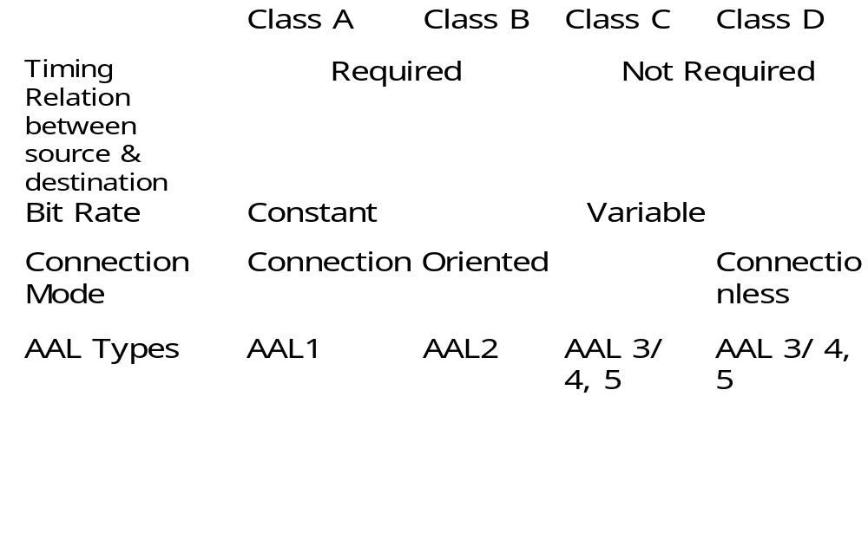
Service Classes and AAL types

Slide 106
Examples
Class A: 64 kbps digital voice
Class B: Variable bit rate encoded video
Class C: Frame Relay Over ATM
Class D: CCITT I.364 (SMDS) over ATM
Class X: Raw Cell service

Slide 107
AAL1 Layer
Transfer of SDU at CBR.
Indication of lost information.
Block of 124 Cells with 4 error correcting cells.
to
ATM
layer
CSI SN CRC P SAR-PDU
1bit 3 bits 3 bits 1bit 47 bytes

Slide 108
AAL1 Layer
Convergence Sublayer Indication (CSI): Two Uses
  CSI bits from four successive cells (1, 3, 5, 7) form Synchronous Residual Time Stamp (SRTS) for source clock recovery at the destination
  For structured Data Transfer
  Structured Data transfer
    CSI = 1 indicates that the first byte of payload is the pointer to start of structured block
    CSI = 0 : no pointer for partially filled cells

Slide 109
AAL1 Layer
SN
    sequence number
    To detect lost or misinserted cell
CRC
    3 bit sequence number protection for detecting error in SN
P
    1 Bit even parity for previous 7 bits

Slide 110
AAL1 Functions
Handling of cell delay variation
  buffer is used
Handling of cell payload assembly delay
Source clock recovery at the receiver
Monitoring of lost and misinterpreted cells and possible corrective action
Monitoring of user information field for bit errors and possible corrective action

Slide 111
AAL 3/4
Designed for Data Transfer
Non real-time VBR
Loss sensitive, delay insensitive
Connection oriented or connectionless
  Connection oriented PDUs may be multiplexed on a VC connection
  Connectionless PDUs are handled separately

Slide 112
SAR - PDU (Cell) Format
Cell
Header
S
T
SN MID Payload SAR-PDU Length CRC
2 4 10 44 bytes 6 10
bits bits bits bits bits
SAR-PDU SAR-PDU
Header Trailer
SAR-PDU
To ATM Layer
  ST - Segment Type
    Indicates which part of the packet (CS-PDU) is carried in the cell : Beginning, Middle, End of message

Slide 113
AAL 3/4 Cell Format
Length : 6 bits
  Indicates the length of payload
  Last cell may have less than 44 bytes
CRC : 10 bits : for the cell
SN - Sequence Number : 4 bits
MID - Multiplexing Identifier : 10 bits
  Allows multiplexing of upto 2¹⁰ AAL users on a single ATM connection

Slide 114
AAL 3/4 Convergence Sublayer
CPI Btag BA Size Data PAD AL Etag Length
8 bits 8 bits 16 bits 0-9188 byte 0-24 bits 8 bits 8 bits 16 bits
Headers
(4 bytes)
Trailer
(4 bytes)
  CPI - Common Part Indicator : 8 bits
    Interpretation of PDU (Format) : Currently one format is defined

Slide 115
AAL 3/4 Convergence Sublayer
B-tag and E-tag
  To tag packets to avoid reassembly to multiple packets into a single packet ; B-tag should be same as E-tag
BA size - Buffer Allocation size : 18 bits
  Inform receiver about the maximum buffer requirement for the packet reassembly
PAD - Padding field : 0 to 24 bits
  To ensure that packet payload is integer multiple of 4 bytes (Actual payload may be 0 to 3 bytes long)
AL - Alignment (32 bit trailer alignment)
  Makes PDU a multiple of 32-bit

Slide 116
AAL 3/4
Higher Layer PDU
CS-H
CS-PDU Payload
P
A
D
CS-PDU
SAR-PDU
SAR-PDU
SAR-PDU
CS-T
SAR-H
SAR
Payload
SAR
T
SAR-H
SAR-PDU
Payload
SAR
T
SAR- H
SAR
T
SAR-H
SAR
T
48 bytes
ATM Cell
ATM
H
ATM Cell Payload

Slide 117
Limitations of AAL 3/4
AAL 3/4 is not suited for high speed connection oriented data services
High overheads: 4 bytes per 48 bytes cell
  10 bit CRC
  4 bit sequence number
    Does not provide enough protection for conveying very long blocks of data

Slide 118
AAL5
VBR, Data service, No timing relation, Connection oriented
No support for multiplexing
Less overhead and better error detection
Can be used for signaling and frame relay over ATM

Slide 119
AAL5
SSCS may be null or may be used for multiplexing
SAP
SSCS
Service Specific
Convergence Sublayer
Common Part
Convergence Sublayer
Segmentation and
Reassembly
CS
AAL
CPCS
SAR
SAR
SAP

Slide 120
SAR - Sublayer
It accepts variable length SAR-SDU (packets) that are an integer multiple of 48 bytes
SAR - PDU (Packet)
From
CPCS
48 bytes 48 bytes 48 bytes
SAR
PDUs
ATM Layer

Slide 121
SAR - Sublayer
For recognition (delineation) of packet boundaries, a bit in PT field in ATM header is used
  0 : Beginning or continuation of packet
  1 : End of packet

Slide 122
AAL 5 Convergence Sublayer
User Data PAD UU CPI Length CRC
0-65535 0-47 1 1 2 4
bytes bytes
PADF : padding
User to user field
  To transparently transfer information between CPCS users

Slide 123
AAL 5 Convergence Sublayer
User Data PAD UU CPI Length CRC
0-65535 0-47 1 1 2 4
bytes bytes
CPI: Common Path Indicator (currently unused)
Length: Length of user data in bytes
CRC: 32 bits

Slide 124
Summary : AAL Layers
AAL1 : Class A services: rt-CBR
AAL 2 : Class B services : rt-VBR
AAL3/4 : Class C and D services
  Quite complex and high overheads
  Useful for connectionless message traffic
AAL5: Class C and Class D services
  Reduced overheads and simple
  very useful for connection oriented stream traffic

Slide 125
Module 8
ATM Traffic Management

Slide 126

ATM Traffic Management
Connection Admission Control and Resources Management
Usage Parameter Control
Priority
Congestion Control
Flow Control

Slide 127
Traffic Contracts
Traffic Contracts of a Connection
  QoS requirements
  Traffic descriptions
  Conformance Definition
  Service category
QoS requirements
  Cell Loss Ratio (CLR)
  Cell Transfer Delay (CTD)
  Cell Delay Variation (CDV)

Slide 128
Traffic Contracts
Traffic Descriptors
  Peak Cell Rate (PCR), Sustainable Cell Rate (SCR), Minimum Cell Rate (MCR)

Slide 129
Traffic Contracts :
Conformance
Guarantees are valid if the traffic conforms to the negotiated traffic Contract
Non Conforming Causes :
  Excessive Rate
  Excessive Burst
Non Conforming Cells may be discarded or when permitted, tagged with CLP = 1 (low priority)

Slide 130
Traffic Contract :
Conformance
For CBR, VBR and UBR, conformance is defined by Generic Cell Rate Algorithm (GCRA) : based on Continuous Leaky Bucket Algorithm

Slide 131
Leaky Bucket Algorithm
Bucket Level
F
L
U
I
D
L
E
V
E
L
Each Incoming Cell Pours T units of fluid into the leaky bucket
The bucket leaks fluid at the rate of 1 unit/μsec
If on arrival of a cell fluid level becomes greater than bucket level, then
the cell is non-conforming

Slide 132
Generic Cell Rate Algorithm
T
L
Maximal Case
Conforming cell
a)
Cell
Cell
T
Next Cell Expected
Slow Sender
Conforming cell
b)
Cell
Cell
Next Cell Expected
T
Fast Sender
Conforming cell
c)
Cell
Cell
T
Next Cell Expected
d)
Cell
Cell
Very Fast Sender
Non-Conforming cell
Next Cell Expected

Slide 133
Generic Cell Rate Algorithm
What happens if the Source continuously sends cells earlier than expected?
0
T
2T
3T
4T
1
T- ε
2
T- ε
3
T- ε
4
T- ε
5
Non-Conforming
Cell
Time

Slide 134
Generic Cell Rate Algorithm
Arrival of a cell at time t
TAT < t ?
Yes
TAT = t
TAT > t + L ?
Non-Conforming
Cell
Yes
No
TAT = TAT + I
Conforming Cell
TAT : Theoretical Arrival Time
L : Limit
I : Increment

Slide 135
Generic Cell Rate Algorithm
Two Types of Models:
GCRA based on Peak Cell Rate (PCR) and Cell Delay Variation Tolerance (CDVT)
  Ideal for CBR
GCRA based on Sustainable Cell Rate (SCR) and Maximum Burst Size (MBS)
  Ideal for bursty traffic.

Slide 136

Traffic Shaping
Traffic shaping is used by the terminal equipment to schedule the entry of cells in the network so the traffic meets the connection traffic descriptors
Leaky Bucket Approach
Traffic Shaping
Source
Network
During Connection

Slide 137
Traffic Shaping
Traffic Shaping increases the efficiency of the resource allocation by introducing more deterministic traffic pattern and thus reduces the burstiness
Traffic Shaping allows the control of CDV at the ingress (entry) of the network. At the egress (exit) of the network, traffic shaping cancels the accumulated CDV

Slide 138
Call Admission Control
To set up new connection without violating QoS of existing connection
For CBR, VBR, UBR traffic no dynamic congestion control is present
When a user wants a new connection, it must describe traffic and service expected

Slide 139
Call Admission Control
Network checks if this connection can be admitted without adversely affecting existing connections
Alternate routes are tried

Slide 140
Resource Reservation
Resources are reserved at call set-up time
Resource reservation based on traffic descriptors : PCR, SCR, etc.

Slide 141
Usage Parameter Control
Check the validity of VPI/VCI
Monitor cells of a connection to determine whether they conform to the traffic descriptions
Tag (CLP = 1), discard or pass the nonconforming cells
Operate in a timely manner without affecting the cell flows

Slide 142
Frame Discard
In AAL5 Frame, even if one cell is dropped, the whole frame is required to be transmitted.
Efficiency can be improved if the network discards total frames rather than individual cells.

Slide 143
Frame Discard
To implement early frame discard, the network watches for the end of AAL5 frames and, if congested, discards the whole next frame instead of of individual cells

Slide 144
Rate based Congestion Control
During Congestion
CBR and VBR traffic can not be slowed down
ABR traffic can be reduced
UBR cells can be dropped

Slide 145
Rate based Congestion Control
After every k data cells, each sender transmits a special RM (Resource Management) cell
The RM cell travels along the same VC and gets special treatment along the way
Absence of backward RM Cell is noticed by the sender (within expected time interval)
the sender reduces the rate

Slide 146
Rate based Congestion Control
ATM
Switch
ATM
Switch
Sender
Receiver
RM Cell
RM Cell
Sender transmits cells at the ACR (Actual Cell Rate) where MCR <= ACR <= PCR

Slide 147
Rate based Congestion Control
Each RM cell contains the value of the rate at which sender would like to transmit (say PCR or lower); this rate is called Explicit Rate (ER)
Each intermediate switch on the way inspects the ER in RM cell. A switch can reduce the value of ER (in case of congestion)

Slide 148
Rate based Congestion Control
Any switch can not increase the value of ER
On receiving an RM cell, the sender can adjust ACR depending on the value of ER

Slide 149
Summary
Call Admission Control
Traffic Descriptors
QoS Parameters
Traffic Shaping
Usage Parameter Control

Slide 150
Module 9
Signaling in ATM Networks

Slide 151
Overview
Signaling :Introduction
Associated/Non-Associated Signaling
Signaling Protocol Stack
Point-to-Point Signaling in ATM
Point-to-Multipoint Signaling in ATM

Slide 152
Signaling: Introduction
ATM is connection oriented
Signaling protocol is required for setup and release of connections
Parameter agreement for each connection between end users and the network
Signaling for point-to-point and point-to-multipoint connections

Slide 153
Non-Associated Signaling
Non-Associated signaling : All VCs in all VPs controlled by one signaling Virtual Channel
VPI = Z
VPI = X
VPI = Y
VPI = 0
VCI = 5

Slide 154
Associated Signaling
Associated Signaling : All VCs in a VP controlled by a particular VC in that VP.
VPI = Z
VPI = Y
VPI = X
VCI = 5
used for
VPI = X

Slide 155
Protocol stack for Signaling
DSS2
Q-2931/71
Higher
Layer
B-ISUP
MTP3
SSCF-UNI
Q-2130
Signaling
AAL
(SAAL)
SSCF-UNI
Q-2140
SSCOP
Q-2110
SSCOP
Q-2110
AAL5
AAL5
ATM
ATM
PHY
Access Node
PHY
Tandem Node
User Node
UNI
NNI

Slide 156
ATM Point-to-Point Signaling

Slide 157
Standards
ITU-T Q.2931 defines procedures for point-to-point signaling.
It uses SAAL as the lower layer for reliable delivery of protocol messages.

Slide 158
Point-to-Point Messages
SETUP
CALL PROCEEDING
ALERTING
CONNECT
CONNECT ACKNOWLEDGE
RELEASE
RELEASE COMPLETE

Slide 159
Point-to-Point Messages
SETUP
  Used to initiate a call/connection establishment.
CALL PROCEEDING
  Used to indicate to the calling user that the call establishment has been initiated.
ALERTING
  Used to indicate that the called user alerting has been initiated.

Slide 160
Point-to-Point Messages
CONNECT
  Used to indicate that the call/connection request has been accepted by the called user.
CONNECT ACKNOWLEDGE
  used to confirm the receipt of the CONNECT message and the acceptance of the call.

Slide 161
Point-to-Point Messages
RELEASE
  Used to initiate clearing of the call/connection.
RELEASE COMPLETE
  used to confirm that the call/connection has been cleared.

Slide 162
Procedures:
Message Flows

Slide 163
Establishing a call
ATM
Network
User
User
SETUP
CALL PROC
SETUP
NNI Messages
CALL PROC
ALERTING
ALERTING
CONNECT
CONNECT
CONNECT ACK
CONNECT ACK

Slide 164
Releasing a call
ATM
Network
User
User
RELEASE
RELEASE COMP
RELEASE
NNI Messages
RELEASE COMP

Slide 165
ATM PMP Signaling

Slide 166
Standards
Q.2971 defines the basic procedures for PMP.
Q.2971 is an extension of Q.2931.
ATM PMP uses SAAL as the lower layer for reliable delivery of protocol messages

Slide 167
Additional PMP Messages
ADD PARTY
ADD PARTY ACKNOWLEDGE
PARTY ALERTING
ADD PARTY REJECT
DROP PARTY
DROP PARTY ACKNOWLEDGE

Slide 168
Additional PMP Messages
ADD PARTY
  Used to add a new leaf to a point-to-multipoint connection
ADD PARTY ACKNOWLEDGE
  Used to acknowledge that the ADD PARTY for a particular leaf was successful

Slide 169
Additional PMP Messages
PARTY ALERTING
  Used to notify that party alerting for a particular leaf has been initiated
ADD PARTY REJECT
  Used to notify that the ADD PARTY for a particular leaf was unsuccessful

Slide 170
Additional PMP Messages
DROP PARTY
  Used to drop a party from a PMP connection
DROP PARTY ACKNOWLEDGE
  Used to acknowledge that the connection to a particular leaf has been cleared successfully

Slide 171
Procedures:
Message Flows

Slide 172
Establishing a PMP Connection
A two-step process
Set up a Point-to-Point unidirectional connection from root to a leaf
  Uses modified Point-to-Point signalling procedures
  Messages have the indication that the connection is PMP

Slide 173
Establishing a PMP Connection..
When the first connection has been established
  Root can add one or more leaves using PMP signalling
  One request per party required
Leaf need not support PMP signalling, Point-to-Point signalling at leaf will do!

Slide 174
ADDING A NEW LEAF
ATM
Network
Root
Leaf
ADD PARTY
SETUP
NNI Messages
CALL PROC
CONNECT
ADD PARTY ACK
CONNECT ACK
A) Without Alerting

Slide 175
ADDING A NEW LEAF
ATM
Network
Root
Leaf
ADD PARTY
SETUP
NNI Messages
ALERTING
PARTY ALERTING
CONNECT
CONNECT ACK
ADD PARTY ACK
B) With Alerting

Slide 176
LEAF INITIATED DROPPING
ATM
Network
Root
Leaf
RELEASE
DROP PARTY
NNI Messages
RELEASE COMP.
DROP PARTY ACK

Slide 177
NETWORK
INITIATED DROPPING
ATM
Network
Root
Leaf
DROP PARTY
DROP PARTY ACK
NNI Messages
RELEASE
RELEASE COMP.

Slide 178
ROOT INITIATED DROPPING
ATM
Network
Root
Leaf
DROP PARTY
DROP PARTY ACK
NNI Messages
RELEASE
RELEASE COMP.

Slide 179
Leaf Initiated Join (LIJ)
Added by ATM Forum in UNI 4.0
Allows leaf to request joining a PMP connection
Independent of whether the call is active/inactive
May not require intervention from Root

Slide 180
Leaf Initiated Join (LIJ)
Additional Messages Required :
Leaf Setup Request : Sent by Leaf to initiate Leaf joining procedures.
  Leaf Setup Failure : Sent to the Leaf by the Root or the Network to indicate that the request to join the call failed.

Slide 181
LEAF
JOINED TO INACTIVE CALL
ATM
Network
Root
Leaf
LEAF SETUP REQUEST
LEAF SETUP REQUEST
SETUP
NNI Messages
SETUP
CONNECT
CALL PROC.
CONNECT
CONNECT ACK
CONNECT ACK

Slide 182
UNSUCCESSFUL LEAF JOIN
ATM
Network
Root
Leaf
LEAF SETUP REQUEST
LEAF SETUP REQUEST
NNI Messages
LEAF SETUP FAILURE
LEAF SETUP FAILURE

Slide 183
Leaf Initiated Join (LIJ)
Two Types of LIJ Calls :
  Network LIJ : Network is responsible for adding leaves that request to join a call.
  Root LIJ : All leaves are added and removed by the Root.

Slide 184
LEAF JOINED
TO ACTIVE ROOT LIJ CALL
ATM
Network
Root
Leaf
LEAF SETUP REQUEST
LEAF SETUP REQUEST
ADD PARTY
NNI Messages
SETUP
CONNECT
ADD PARTY ACK.
CONNECT ACK

Slide 185
LEAF JOINED TO
ACTIVE NETWORK LIJ CALL
ATM
Network
Root
Leaf
LEAF SETUP REQUEST
SETUP
CONNECT
CONNECT ACK

Slide 186
ISSUES
Unidirectional PMP Connections
  Cell Interleaving in AAL5 not possible
  Additional complexities in using AAL3/4
Connection characteristics negotiation possible for first party only
LIJ not supported in PNNI 1.0
ABR PMP connections involve feedback consolidation problems

Slide 187
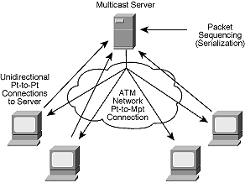
Providing
Bi-directional Connections
Multicast Server
  Server with PMP connection with all leaves
  Point-to-Point connection with all senders.

Slide 188
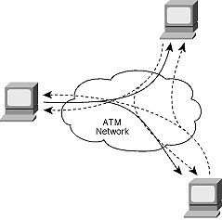
Providing
Bi-directional Connections
Overlaid PMP Connections

Slide 189
Providing
Bi-directional Connections
VP Multicasting
  Multipoint-to-multipoint VP links all nodes
  Unique VCI value for each node
  Interleaved packets identified by unique VCI.
  Requires a Protocol to uniquely allocate VCI values to nodes.

Slide 190
CONCLUSIONS
ATM has no implicit broadcast mechanisms
No ideal solution within ATM for Multicast
PMP Connections have a wide range of applications
In PMP Connections, only root can add parties as of now.
Mechanisms to work around above problems being evolved

Slide 191
Signaling References
ITU-T Q.2931: B-ISDN UNI Layer 3 Specification for Basic Call/Connection Control
ITU-T Q.2971: B-ISDN UNI Layer 3 Specification for Point-to-Multipoint Call/Connection Control
ATM Forum UNI 4.0

Slide 192
Signaling References
Signaling in ATM Networks : Onvural
ATM Internetworking : Anthony Alles
Design and Evaluation of Feedback Consolidation for ABR PMP connections in ATM Networks : Fahmy, Raj Jain et al.

Slide 193
Module 10
Related Topics

Slide 194
Related Topics
Routing in ATM Networks (PNNI)
LANE
MPOA
VTOA

Slide 195
PNNI
Private “Network-to-Network” or “Network-to-Node” Interface
Two key protocols:
  PNNI Routing : Hierarchical, state-of-the-art routing protocol.
  PNNI Signaling : Based on Q.2931, extended as necessary.

Slide 196
Topology State Routing
Each node periodically:
  Exchanges “Hello” packets with directly neighboring nodes.
  Constructs a “Topology State Update” (TSU) describing the node and listing links to direct neighbors.
  Floods TSUs to all other nodes.
Nodes then can compute complete topology.

Slide 197
Concept of “Source Routes”
Ingress nodes choose a complete path to the destination.
Ingress node then adds full path to the message itself.
Transit nodes simply follow the given path.

Slide 198
PNNI Routing Hierarchy
Aggregating Information “Up” the hierarchy.
B
A
B.2
A.2
B.1
C
A.1
B.3
A.2.1
A.1.3
B.1.1
B.2.1
B.1.2
B.3.2
C.1
A.2.2
A.1.2
B.1.3
B.3.1
C.2
A.1.1
B.2.2

Slide 199
PNNI Signaling
(Key Concepts)
Complete Source routing across each level of hierarchy
Use of Designated Transit Lists
“Crankback” and Alternate Path routing

Slide 200
PNNI Signaling
DTL : Implemented as “push-down/pop-off stack”
User A
User B
S3
SETUP
S2
S1
S5
S1 S2 S4 S5 SETUP
S4
DTL

Slide 201
LANE
LANE stands for LAN Emulation
LANE provides for:
  all existing LAN applications to run over ATM
  the use of ATM as a backbone to interconnect existing “legacy” LANs
  the interconnection of ATM-attached servers/workstations to each other and to those on “legacy” LANs

Slide 202
LANE
An ATM network interconnecting multiple Ethernet segments and ATM-attached end-systems
Ethernet
Ethernet
ATM
Network
Bridge
Bridge
ATM-attached stations

Slide 203
LANE
LAN Emulation Protocol Stack
Existing Applications
Existing Applications
NDIS/ODI Driver I/f
Bridging
NDIS/ODI Driver I/f
LAN
Emula
tion
LAN Emulation
MAC
MAC
AAL5
AAL5
ATM
ATM
ATM
Phy. Layer
Phy.
Phy.
Phy.
Phy.
Phy. Layer

Slide 204
MPOA
Multiprotocol Over ATM
MPOA is an Evolution of LANE
LANE operates at Layer 2 (Bridging)
MPOA operates at both Layer 2 (Bridging) and Layer 3 (Routing)
MPOA will use LANE for its Layer 2 Forwarding

Slide 205
Benefits of MPOA
Provides the connectivity of a fully routed environment
Eases introduction of ATM in Campus environment
Provides direct ATM connections between MPOA devices.
Presents Unified approach to Layer-3 protocols over ATM

Slide 206
VTOA
Voice and Telephony Over ATM
Objective : To allow the interconnection of private Narrowband Networks through an ATM Broadband network in order to :
  Integrate service specific networks
  reduce communication costs
  simplify the operational environment
  simplify network management

